Slide 1
Build your own Wi-Fi automation lab Day 1 presentations
Andreas Koksrud / Telenor Bedrift

Slide 2
References / inspiration
References
https://github.com/CiscoDevNet/yangsuite/
https://postman.com
https://docs.ansible.com/ansible/latest/collections/cisco/ios/ios_facts_module.html
https://www.wifireference.com/2020/01/14/viewing-network-telemetry-from-the-catalyst-9800-with-grafana/
https://grafana.com/grafana/dashboards/13462-device-health-monitoring/
https://grafana.com/grafana/dashboards/12468-catalyst-9800-client-stats/
https://wirelessisfun.wordpress.com/2020/12/10/network-telemetry-data-and-grafana-part-1-the-advanced-netconf-explorer/
https://python.org
https://codeium.com

Slide 3
Copyright
Copyright
© Andreas Koksrud 2024. All rights reserved. This presentation is provided for educational and informational purposes only. You may distribute and learn from this presentation, but commercial use or any form of monetization is strictly prohibited without prior written consent.

Slide 4
Prerequisites
Communications
Cisco.com account with
Access to downloading WLC (9800-CL at https://software.cisco.com)
Access to DevNet Sandbox (https://devnetsandbox.cisco.com/)
Postman account (https://postman.com)
Windows laptop with administrative privileges
Without these, parts of the Deep Dive might be difficult to complete, or steps might differ severely

Slide 5

Communications
Communications
WebEx space: Wi-Fi automation lab
Please help each other
Sharing is caring ☺

Slide 6
Agenda
Agenda
Pre-lab
Install VirtualBox
Install Cisco 9800-CL
Install Ubuntu Server w/Docker
Install Postman
Install VS Code
Day 1
Get to know the lab environment
Day 2
In-depth explore a topic of choice
Finish the pre-lab tasks
Configure your AP
Explore Postman
Install and explore Grafana
Grafana / TIG-stack
Grafana Cloud
Ansible
Python
Other vendors (MIST? Meraki?)
Connect VS Code to Ubuntu
Install and explore Ansible
Explore Python automation
Install and explore YANG Suite

Slide 7
Agenda - About Day 2 choices...
Agenda
Choose a track Horiontal - A taste of everything (try to cut at 1h for each) Vertical - 3h deep dive into one of the topics
Ansible
Run a CLI command
CLI configuration
Using Jinja2 templates
Using RESTCONF
Write your own module
Python
Grafana
Using Netmiko
RESTCONF + own module
Organizing projects
… more to come
Using RESTCONF
Get metrics, draw a graph
Working with AI companions
Using .env files
Nornir automation framework
More Nornir
… more to come
Working with syslog
Finish building your own TIG stack from day 1
Extended C9800 dashboard
… building more
… and improving even more

Slide 8
Scope
Scope
In scope
Getting started with various systems/languages/solutions for lab purposes
Get a lab environment up and running on your own laptop
Some nice examples to try various aspects of automation
Inspiring you to explore deeper on your own
Out of scope topics
Git
Learning the languages (Ansible, Python, InfluxQL, etc)
Deploying the systems for production use

Slide 9
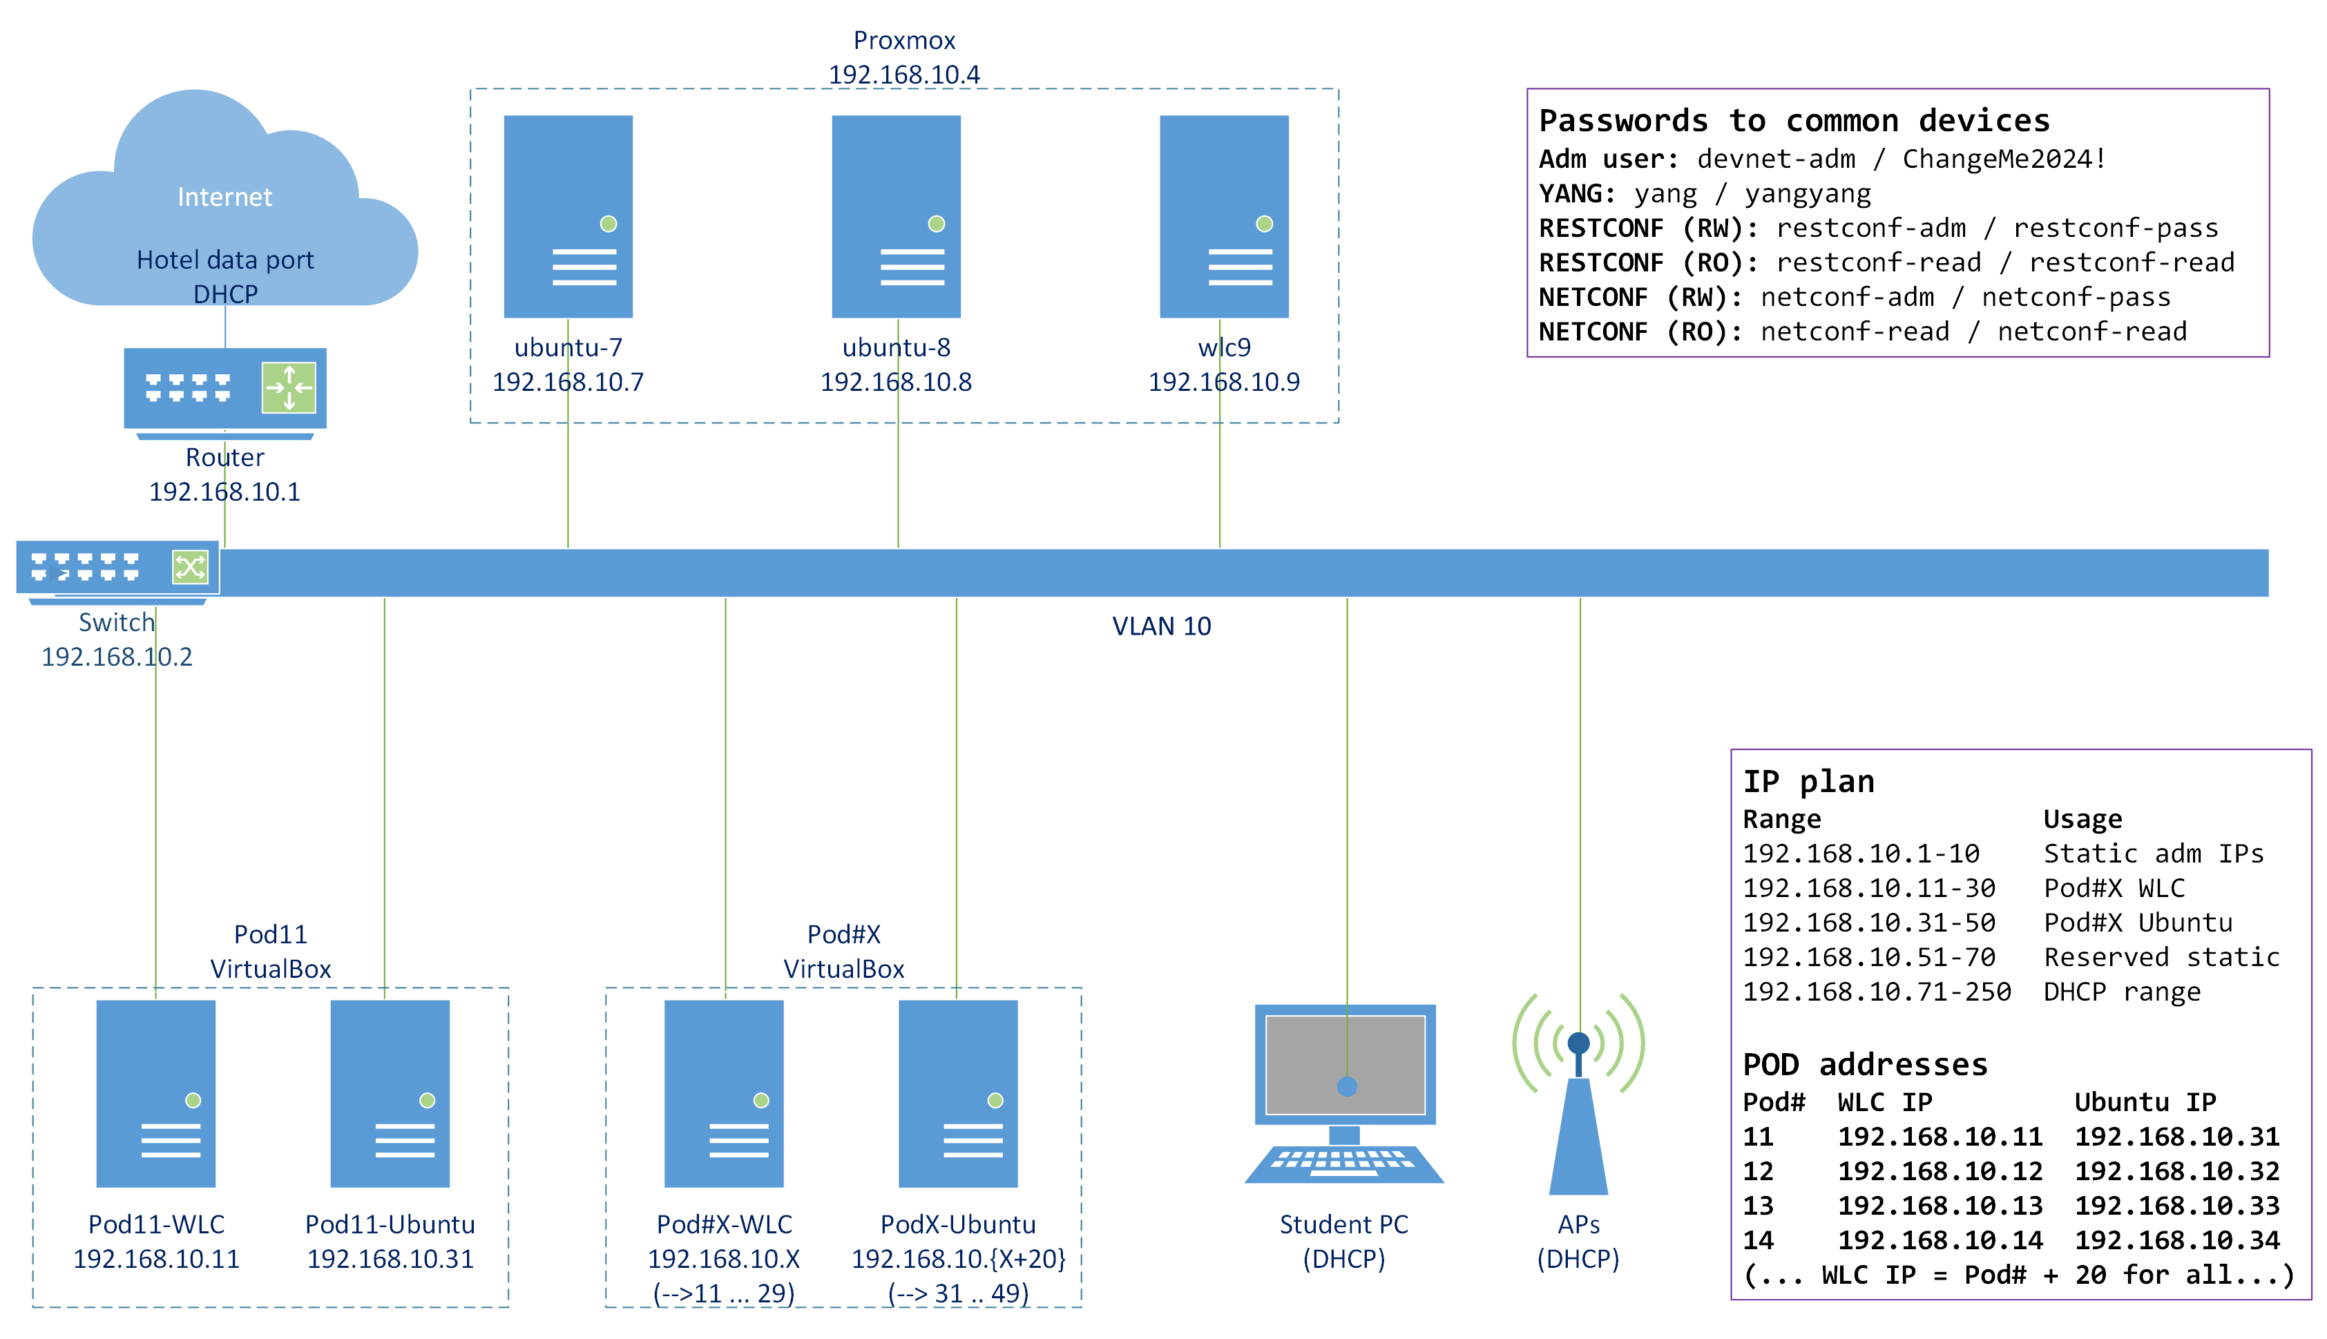
Topology
Lab topology

Slide 10


About us
About us
Andreas Koksrud
Telenor
Wi-Fi & Automation nerd
M.Sc Communications technology + a bunch of Cisco certs)
Kjetil Teigen Hansen
Conscia
Wi-Fi, monitoring and RF nerd
CWNE#504 + a bunch of Cisco certs

Slide 11
Automation in the Wi-Fi lifecycle
Automation in the Wi-Fi lifecycle
Some examples of automation in different phases
Prepare
Python scipt for information gathering / network mapping / device walking
Plan
Python script for large-number analysis of devices (and/or maybe Excel is better for parts of it)
Design
Prepare data to use in the Implement phase
Implement
Python script for creating IP pools, or creating site hierarcy etc in DNAC
Ansible and/or some vendor specific Zero-Touch provisioning variants for device config based on some source of truth
Operate
Write Python scripts for changes that involve large number of devices
Ansible for repeating tasks
Grafana for real-time troubleshooting
Optimize
Grafana for monitoring/graphing/analysis
Python scripts or Ansible playbooks to analyze possible optimizations (APs on 100Mbit, hostnames of neighbors that differ, etc)

Slide 12
VirtualBox - Type 1 vs Type 2 hypervisors
Hypervisors
Type 1
Bare-metal (run directly on hardware)
Superior performance
Type 2
On top of another OS
For production use
Examples
VMWare ESXi
Proxmox
KVM
Xen
Nutanix
Flexible, can run on your laptop
For lab purposes or at least non-24/7
Examples
VirtualBox
VMWare Workstation
Parallels
Hyper-V

Slide 13
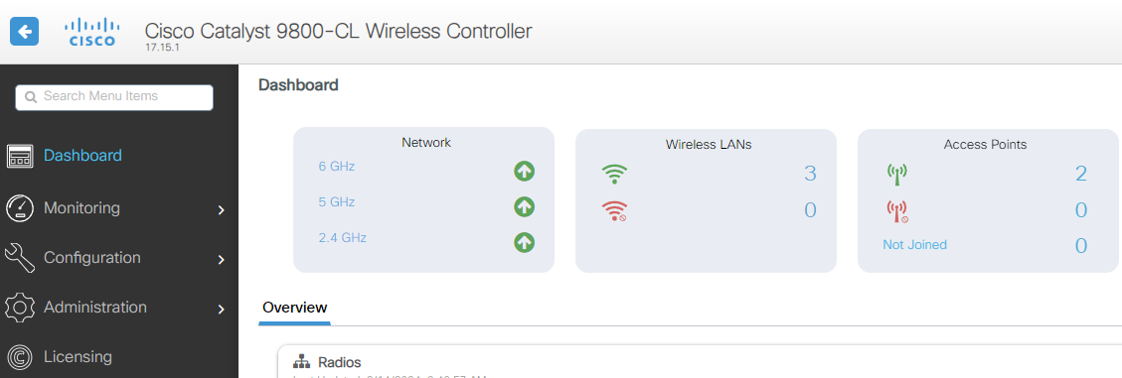
WLAN Controllers
WLAN Controllers
This lab use Cisco 9800-CL WLC
Project the knowledge to your platform of choice
Other vendors WLAN Controllers or similar concepts
Cloud-managed solutions often have good APIs
Ansible, Python, etc have lots of collections

Slide 14

Ubuntu Server
Ubuntu Server
This lab use Ubuntu Server
Most stuff can be done directly on your own laptop
Currently Ansible can not run directly on Windows
TIG stack ... maybe(?)
I like to play with stuff using a server, I find it easier to transfer to live systems
WSL (Windows Subsystem for Linux) is a very good alternative for Python and Ansible. For Grafana it might be more tinkering

Slide 15
Docker
Docker
This lab use Docker as the container platform
Pre-made packages for TIG stack and YANG Suite
Could just as well be using Kubernetes etc

Slide 16
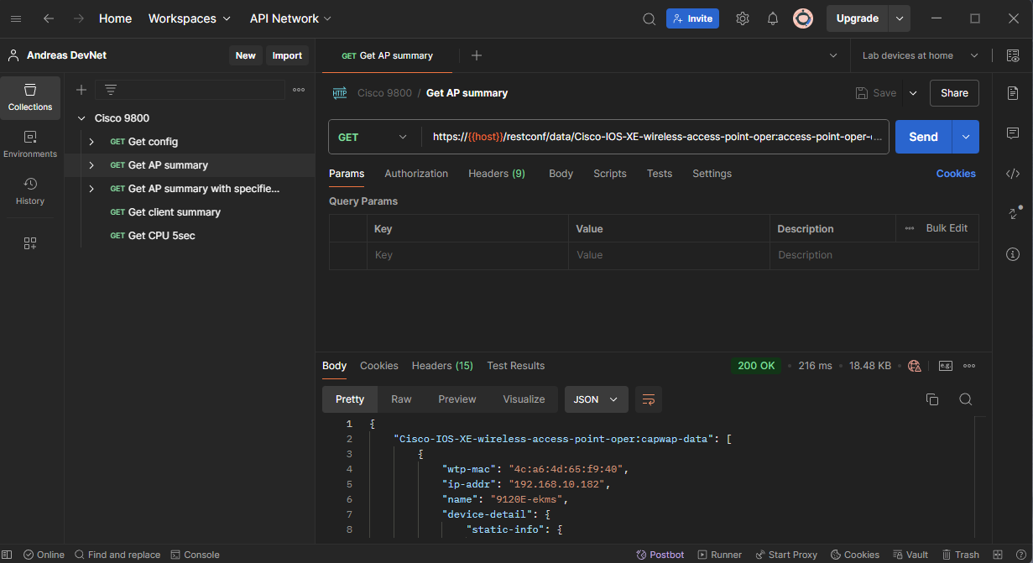
Postman
Postman
Postman is a "go-to" tool for RESTCONF APIs. Some examples for automation are
Exploring RESTCONF calls
Checking the datastructure you get in return
Validating the calls to devices before implementing in Python, Ansible, etc
Get example code in your preferred language for that specific RESTCONF call

Slide 17
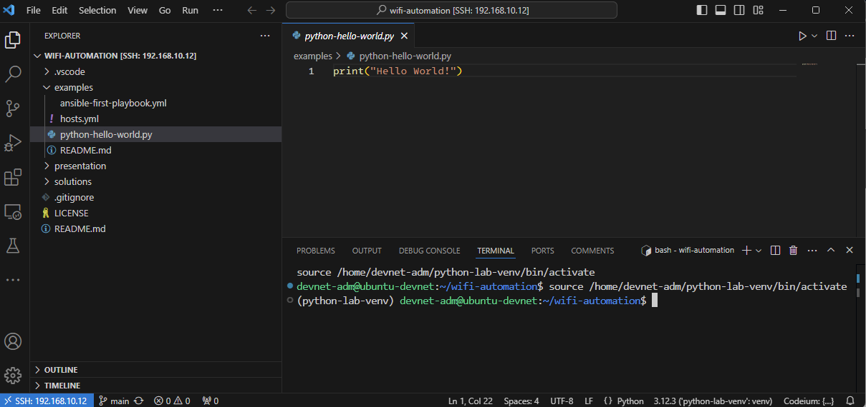
VS Code
VS Code
This lab use VS Code as text editor / development environment
Some other popular alternatives for all or parts of the process
VS Codium
Atom
Notepad++
Jupyter Notebook
Anaconda ecosystem

Slide 18
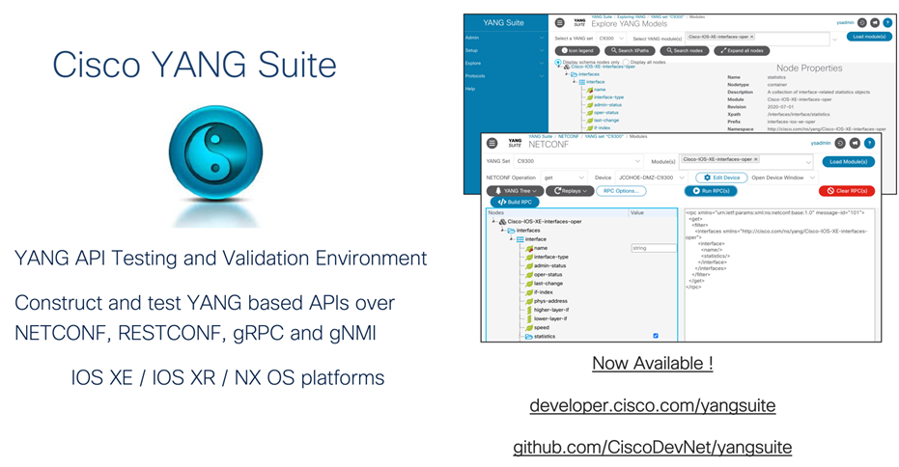
YANG Suite
YANG Suite
Testing and validation environment for YANG related tasks
Install as a docker container
We will use this to explore the world of YANG models present in the Cisco 9800 WLC

Slide 19




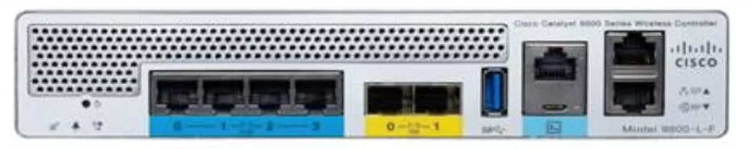

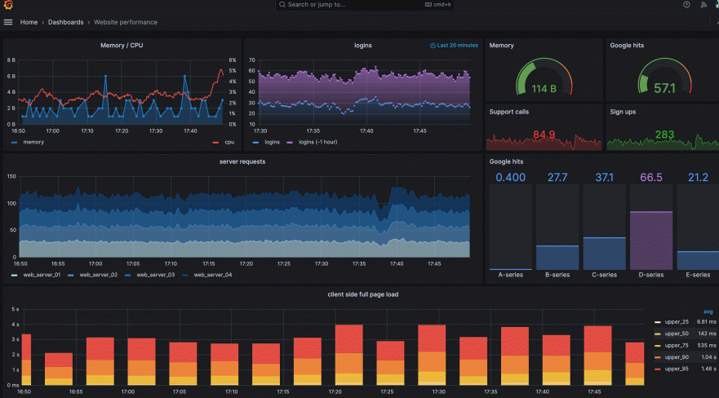



TIG Stack
TIG Stack
Bla bla about what is TIG stack
gRPC / TCP 57000
C9800
metrics goes to the database
Wow!
TCP 8086
Grafana to visualize
WebUI – server:3000
TCP 3000

Slide 20
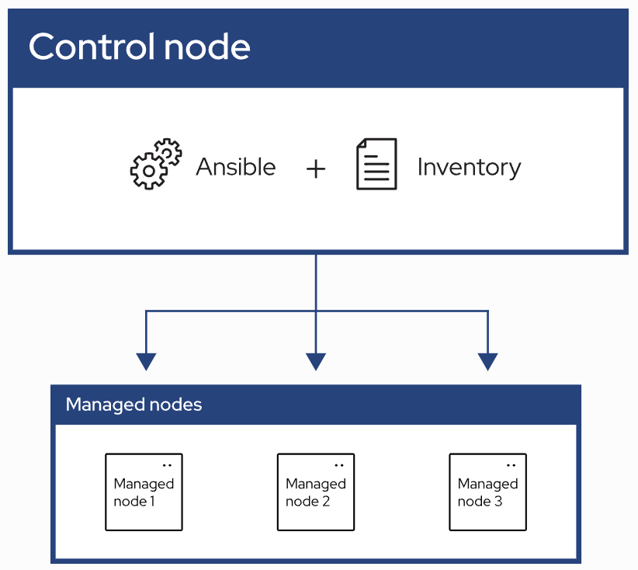
Ansible
Ansible
Automation using "playbooks" written in YAML format
Agent-less architecture
No installation on the managed nodes
Idempotency
Does not change/write if target is already in state described by playbook
Control node
System where Ansible is installed and runs the playbooks
Inventory
List of managed nodes where the playbook will affect
Managed nodes
Remote systems that are the targets of your playbooks

Slide 21
Pod numbers
Ansible
Students get pod numbers ranging from 11 and up
Your WLC will have last octed equal to your assigned Pod#. Ubuntu will have Pod# +20
Pod# | WLC IP | Ubuntu IP | Name
11 | 192.168.10.11 | 192.168.10.31 | Tauni
12 | 192.168.10.12 | 192.168.10.32 | Samuel
13 | 192.168.10.13 | 192.168.10.33 | Payman
14 | 192.168.10.14 | 192.168.10.34 | Hans
15 | 192.168.10.15 | 192.168.10.35 | Michal
16 | 192.168.10.16 | 192.168.10.36 | Stephen
17 | 192.168.10.17 | 192.168.10.37 | Sigurd
18 | 192.168.10.18 | 192.168.10.38 | Konrad
19 | 192.168.10.19 | 192.168.10.39 | Ed
20 | 192.168.10.20 | 192.168.10.40 | Yifan
21 | 192.168.10.21 | 192.168.10.41 | Nick
22 | 192.168.10.22 | 192.168.10.42 | Marek
23 | 192.168.10.23 | 192.168.10.43 | Martin
24 | 192.168.10.24 | 192.168.10.44 | Igor
25 | 192.168.10.25 | 192.168.10.45 | Piotr
26 | 192.168.10.26 | 192.168.10.46 | Tór
29 | 192.168.10.29 | 192.168.10.49 | Kjetil
30 | 192.168.10.30 | 192.168.10.50 | Andreas

Slide 22
Feedback on pre-lab tasks?
Ansible
We really need feedback to make this deep dive better ☺
Pre-lab or anything else!

